Slide 1
INTELIGENT SYSTEMS
Genetic algorithm – Denis, kacper and kirill.

Slide 2
Introduction
The idea of genetic programming is that instead of coding a robocode controller by hand, we can produce tanks that programme automaticallly using evolution.
There are 2 robots and 2 classes that we have created in this project.
Environment class which is resposible for the set up of the project.
The other class is the robotic fitness function class.
In this presentation we will describe what each class does and we will talk about the JGAP library that we have implemented.

Slide 3
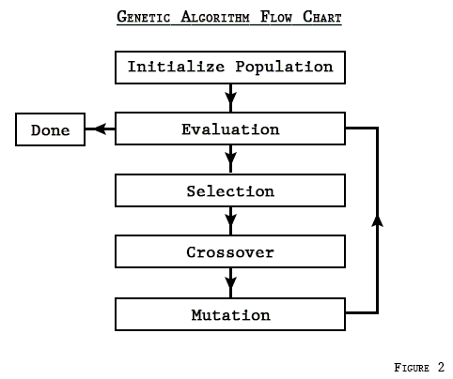
JGAP
We import the fitness function, chromosome, the gene the genotype and the ichromosome.
A fitness function is a type of objective function, which summarises how close we are to a given solution.
Genotype is how your genes looks like. Chromosome is a structure of the so called DNA.
Chromosomes are basically a string of numbers, the higher the value after evaluating the chromosome, the better the fitness function and the more effective the genetic algorithm is.

Slide 4
Environment Class
In this class we set up the Genes to be an array of 4, being the minimum speed, the range of speeds, the maximum distance between two robots and the probability of speed change.
We also create a random initial genotype. we let it evolve and the fittest chromosome is found in this class. This is done in the evaluation, when no previous configuration was found.
The class writes out to a config file, which contains the best configuration found by evolving the population, and then it loads the battle with that configuration file.

Slide 5
Robot fitness class
This class is responsible for starting up robotcode and to make sure that every time a robot starts the position is constant so that the battle is deterministic so that the genetic algorithm will be more effective.
The evaluate method, evaluates the chromosome, the higher the value in the difference between a robot and an enemy the fitter the individual is.
In this class the configuration is either saved or not, if the solution is better than the previous, the configuration is saved for a more effective Genetic Algorithm.

Slide 6

Results
As seen by the results, the higher the value in the difference between a robot and an enemy the fitter the individual is. The genetic algorithm of ours gets 100%.

Slide 7
Conclusion
The Jgap library is very useful as it helps us to eliminate redundant code that would just be repeated.
The fitness function can be used to determine a summarised single figure solution to the problem.
The Robocode application helps us to understand the genetic algortihm and how it works with chromosomes, genes and how it evolves to find the best fitting solution.

